Slide 1

SERVICE PRO
PRESENTED BY:
Sajit Gurung
Nabin Adhikari
Ankit Poudyal

Slide 2
INTRODUCTION
"Service Pro" is a service provider app designed to streamline service delivery.
Easily connect service providers with users.
Providers apply for chosen services, matching skills with user needs, while users connect smoothly with providers.

Slide 3
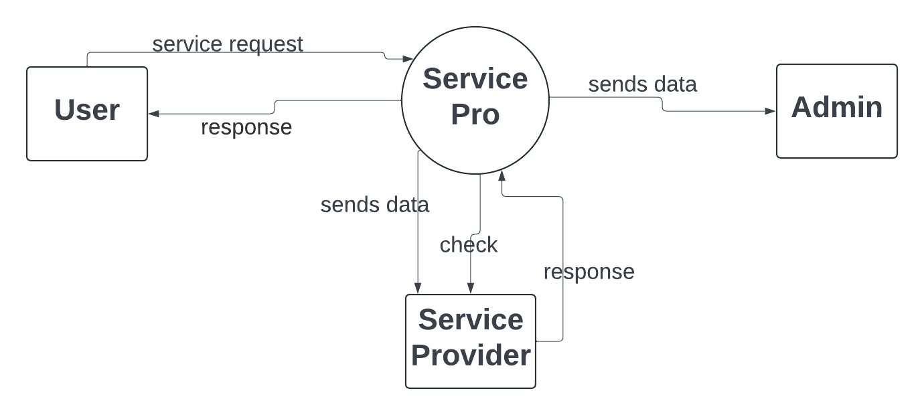
CONTEXT LEVEL DFD

Slide 4
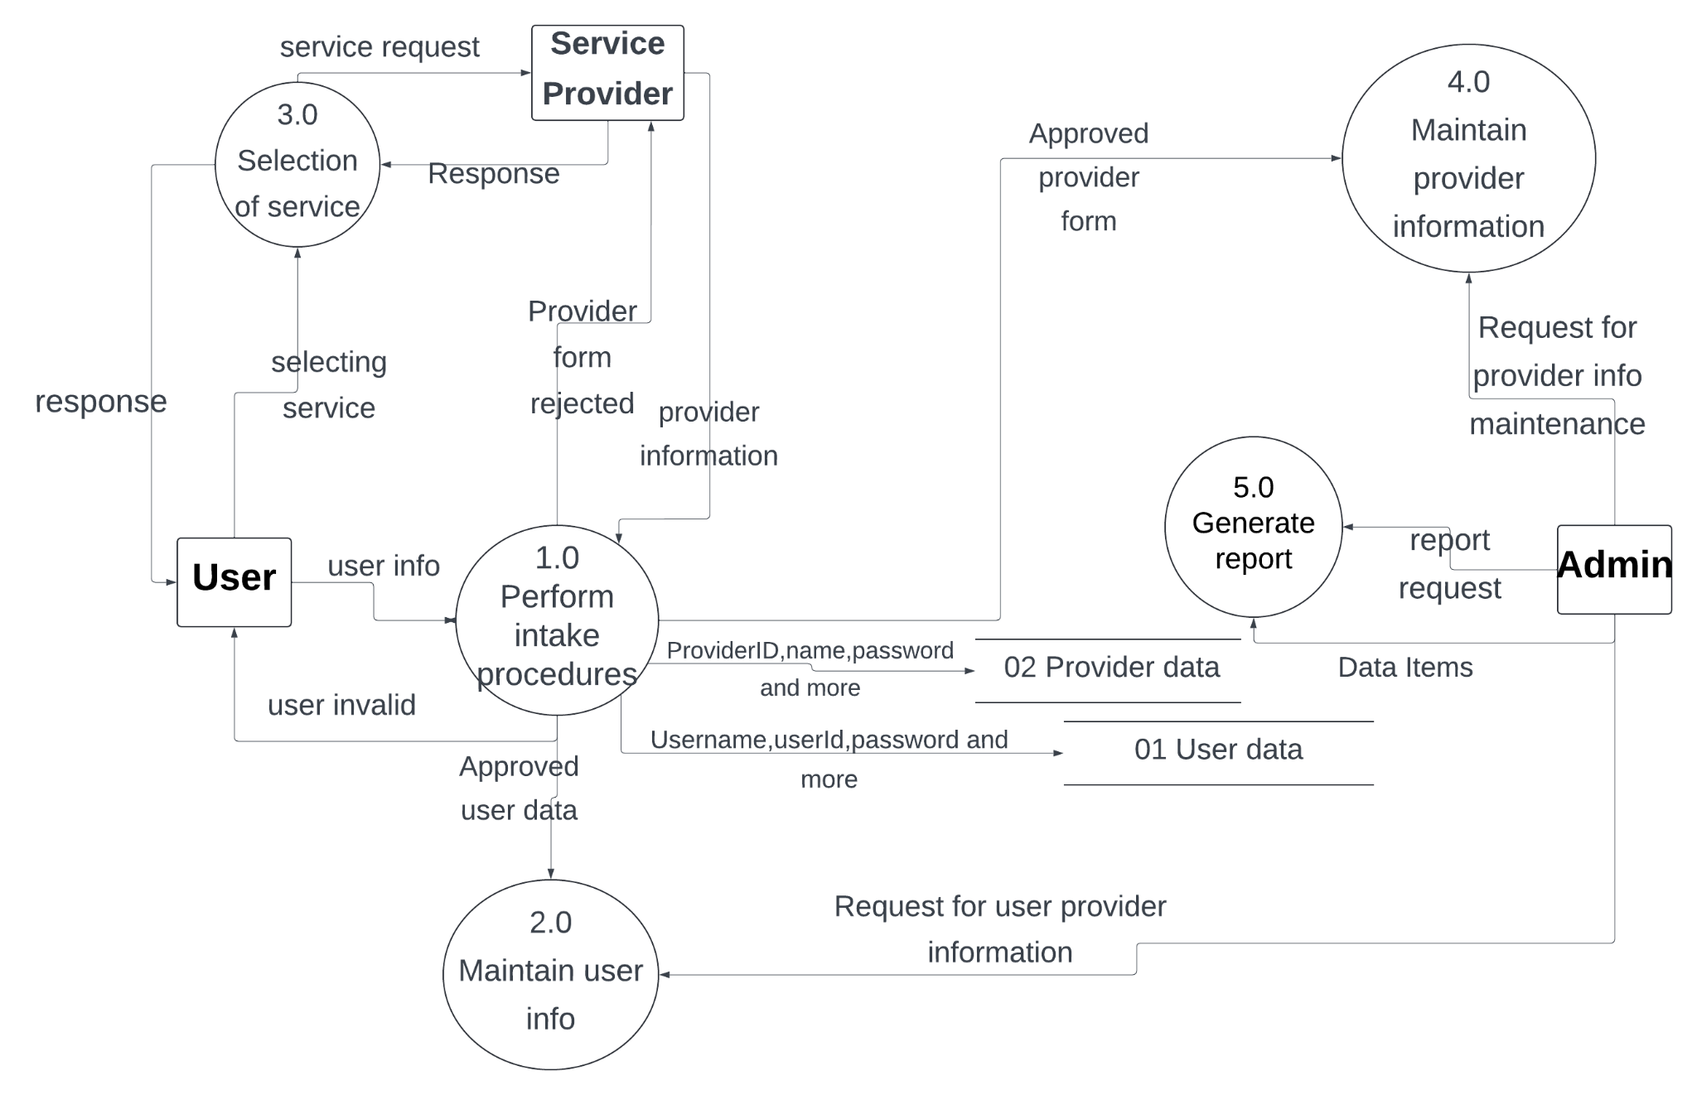
DFD LEVEL ONE

Slide 5
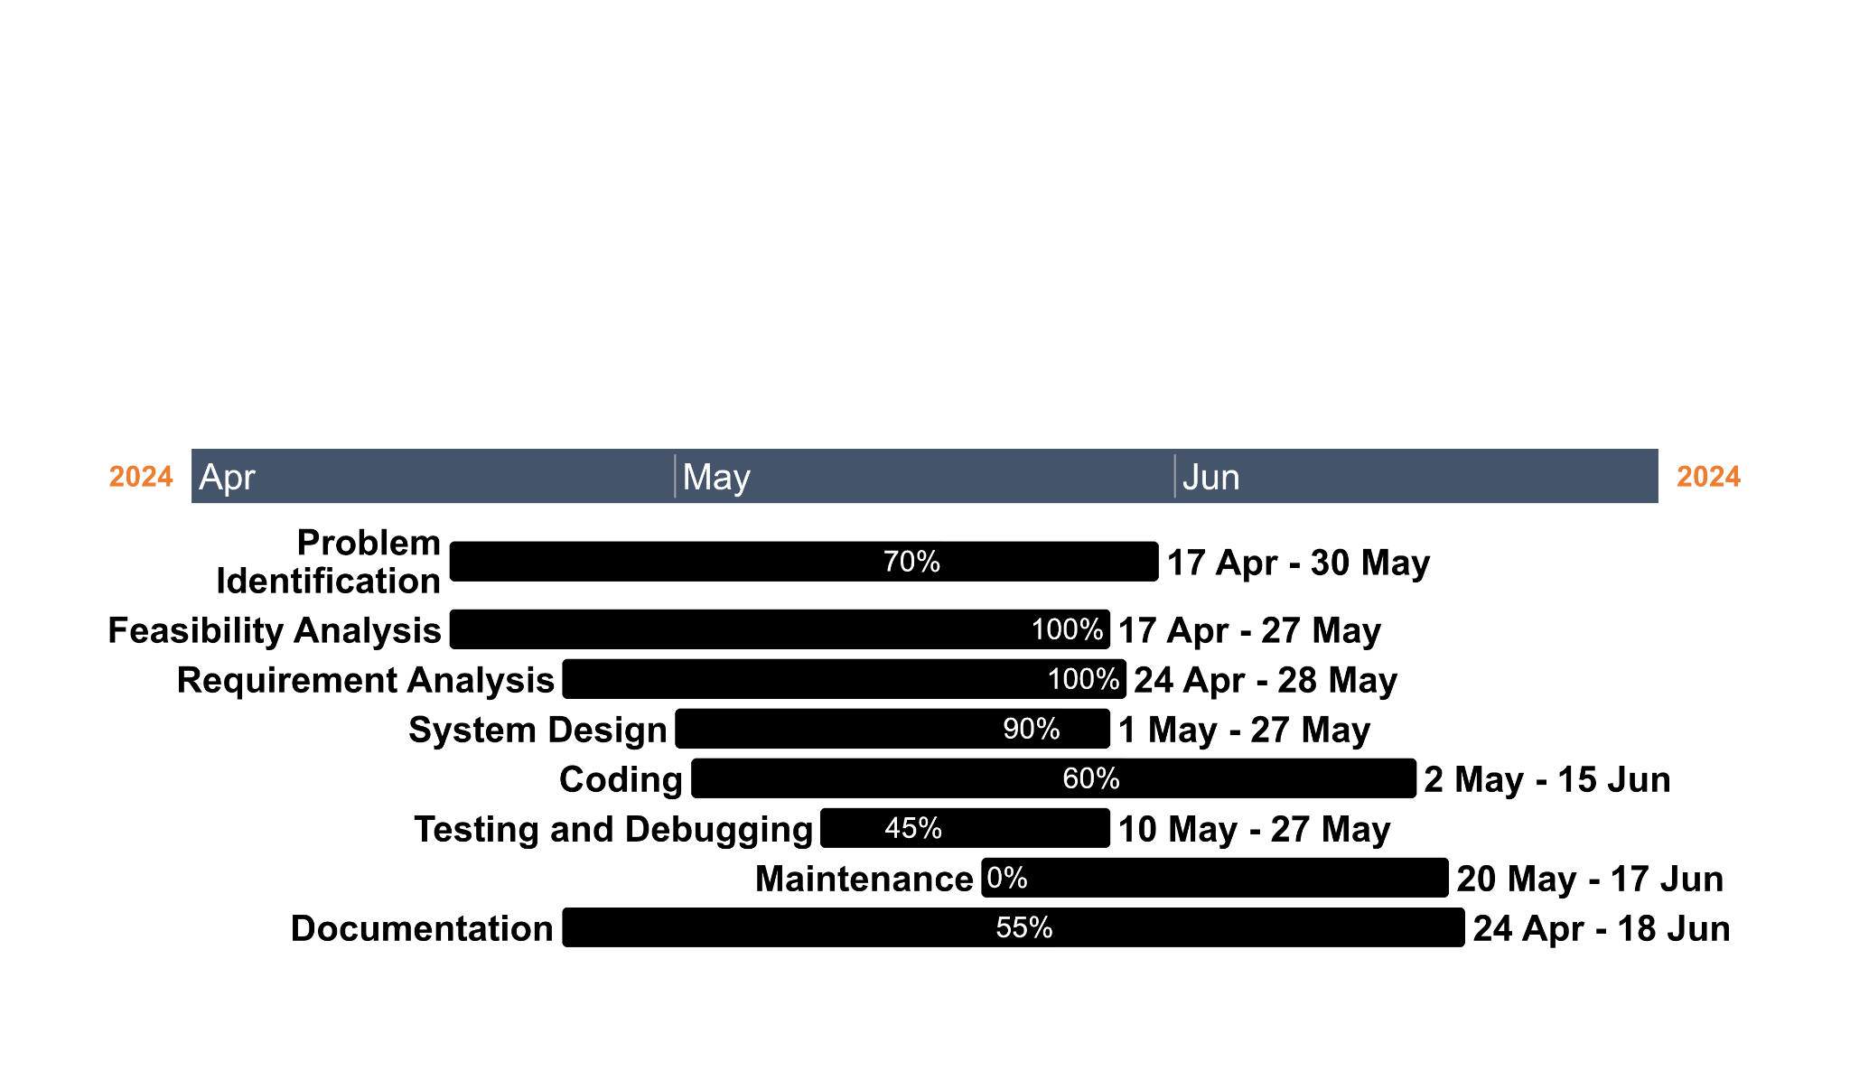
Gantt Chart

Slide 6
FLOW CHART

Slide 7
DATABASE SCHEMA

Slide 8
ANNEX

